Slide 3
Introduction
The nucleus of all living organisms if found to have a thread like structure called a chromosome.
The chromosome is clearly visible in metaphase stage.
In the interphase stage chromosome appears as chromatin.
The capacity of self duplication is found in the chromosome.
The chromosome is called heredity vehicle.

Slide 4
History
In Hofmeister(1848) , the Chromosome was observed in the nucleus of the Tradescantia
pollen mother cell.
In Strasburger(1857) , describe the thread like filamentous structure that appeared at the time of cell division .
In Waldeyer (1888) ,this thread like structure was named chromosome.

Slide 5
Definition
"Chromosome are self reproducing thread like structure found inside the nucleus of a eukaryotic .They are true vehicle of heredity."

Slide 7
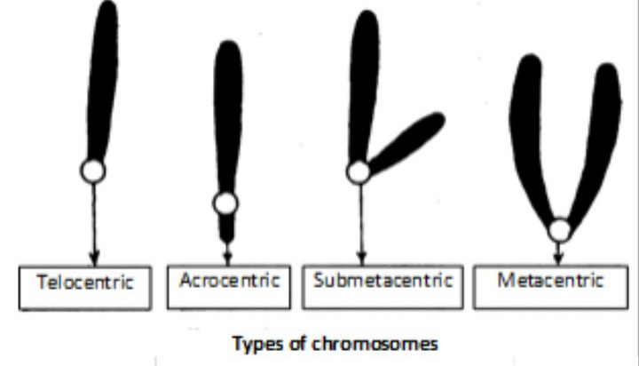
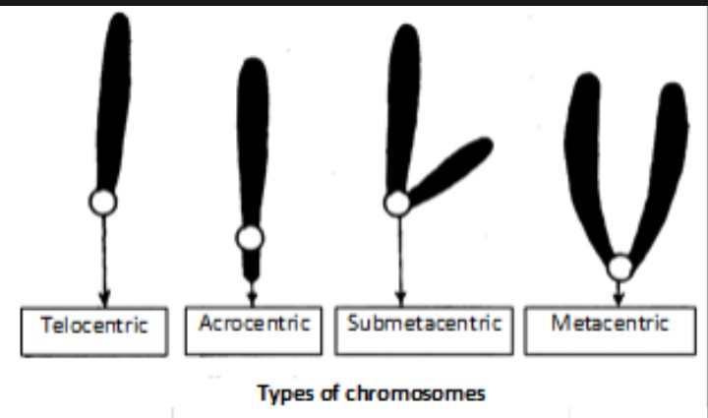
Types of chromosome
A- On the base of location of centromere:-
1- Acrocentric. 2. Telocentric.
3- Metacentric. 4.Sub metacentric.

Slide 8
B- On the base of number of chromosome:-
A- Acentric.
B- Monocentric.
C-Dicentric.
D- multicentric/ polycentric.

Slide 9
Morphology of chromosome
Number of chromosome:- Two Set of chromosome are found in the somatic cell ,which is called diploid cell.
*A set of chromosome is found in the germ cell, which is called the haploid cell.
Size of chromosome:- Different plants have different chromosome size.
*The chromosome is of length from 0.5 to 30u.
*The chromosome varies from 0.2 to 0.3u thick.

Slide 10
* The size of the plants chromosome is larger than the size of animals chromosome.
* The chromosome size of monocot plants is larger than the chromosome size dicot plants.
Shape of chromosome:- The chromosome is present in rod shaped , coiled , filamentous , cylindrical form.

Slide 11
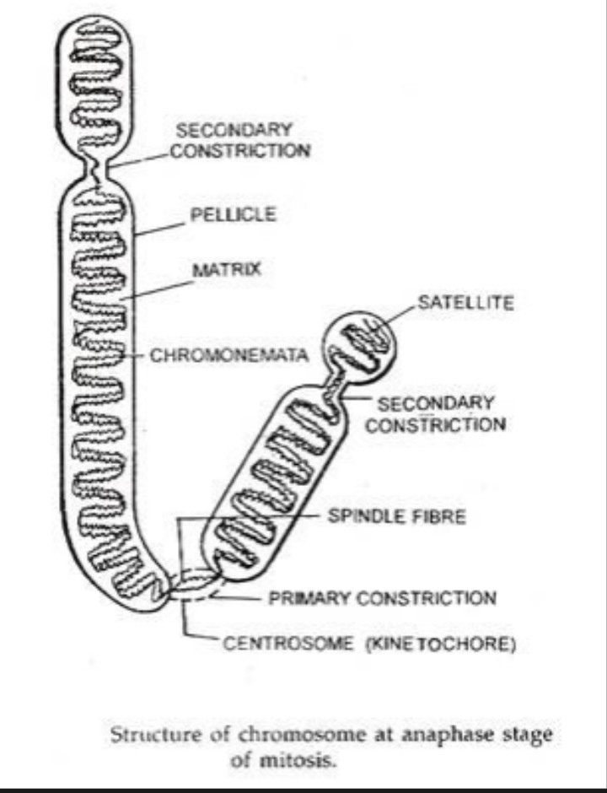
Structure of chromosome
Pelical:-The present outer member around the chromosome consists of thin ,permeable ,colourless, acrotein, non genetic elements.
Matrix:- Inside the pelical is a jelly like structure called the matrix.

Slide 12
*The matrix determiners the chromosome boundaries.
Chromonemata:-The chromonemata consists of nucleoprotein.
*It was a fibre like structure filament, which is 800A thick Vejowski named chromonemata.
Chromomere:- Small granules like structure are found in chromonemata , which is called chromomere.
*Balbioni called the chromomere the present granules like structure on chromonemata in the prophase stage.

Slide 13
Secondary constriction:- The addition of primary construction and centromere in chromosome , secondary constriction is found.
Centromere:- Two the centromere is located in the middle of the chromosome.
* The position of the centromere is ,this is the peculiarity of the chromosome.
Secondary constriction:- In addition of primary construction and centromere in chromosome, secondary constriction is found.
* They are two types of secondary constriction:-
A -Secondary constrict-1
B- Secondary constriction-2
Telomere:- The telomere displays the last part of the chromosome.

Slide 14
* Sc. Mular named him telomere in(1938).
*The telomere is formed by the DNA being
folded.
Chemical composition
The chromosome is made up of DNA , RAN ,and protein .
1-DNA:- DNA is an important part of the
chromosome , which make up 35% of the
chromosome.
2-RNA:- RNA make up 5% of the chromosome.
RAN is composed of r- RAN , t- RAN and

Slide 15
m- RNA.
Protein:- Proteins make up 60% of the chromosome. Proteins consists of histone and non histine protein.
A.-- His tone protein:- Histone protein make up 55% of the chromosome.
B.-- Non his tone protein:-Non histone protein make up 5% of the chromosome.

Slide 16
Packaging of DNA
" The process of the DNA chain being packed into the nucleus with the help of histone protein called DNA packaging. "
DNA packaging of model
1:- Folded fiber model of DuPraw.
2:- Nucleosome model
3:- Solenoid model
1:- Folded fiber model of DuPraw:- proposed by
DuPraw (1965).
*The details of chromosome structure acco -

Slide 17
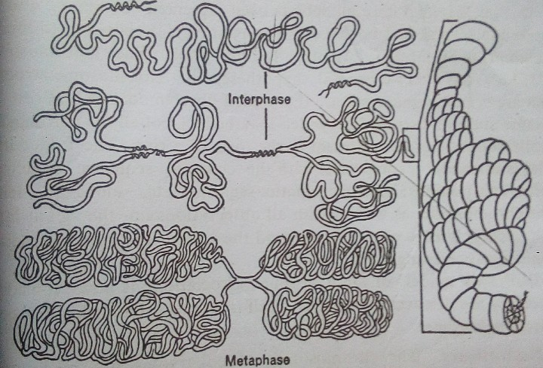
riding to the DuPraw model are as follow.
* The 20 A DNA double helix , 56 microns long is spirally packed in protein to form a fibril.
* The fibril if coiled would from a fibre 10 to 100
A in diameter and 7 to 8 microns long .
*This fibre is called the Type A fibre. The DNA is

Slide 18
Packed inside the Type A fibre in a packing ratio
of at least 6:1.
* The Type A fibre is then in turn coiled in a packing ratio of 10:1 form a Type B fibre 200 to 250A in diameter.
*The total packing ratio of DNA in the Type B fibre averages 56:1.
* The 200 to 250A Type B fibre is extensively folded to form the chromatid.
2:- Nucleosome model:- Proposed by Karnbarg
& Thamas (1974).
* DNA and histone protein combine to complete the process of DNA packaging.

Slide 19
* DNA packaging consists of two types of
Composition-
1.DNA
2. Histone protein
*This is negative charge in the DNA in which
Phosphate group is present
* This is positive change in the histone protein
in which orginine and histidine are present .
* Types of histone protein -H1, H2A, H2B, H3,H4.
* Mechanism --
* First , four protein multiplication of histone

Slide 20
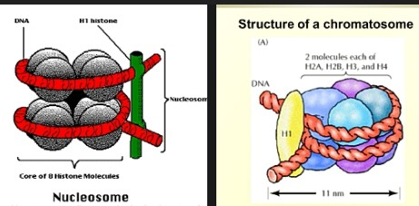

Slide 21
Protein H2A, H2B, H3, H4 leads to the forma-
tion of 8 proteins.
*These 8 protein are arranged in a ball like str-
ucture called core protein.
* The DNA core wraps 1.75 parts of the protein.
* The protein of DNA inside the core protein remains wrapped 146 BP is found in that DNA.
* The core protein and nucleoprotein together form the Nucleosome.
* The two strands of DNA bind to the histone protein H1 , which is called linker protein.
* The DNA that is used for binding is called

Slide 22
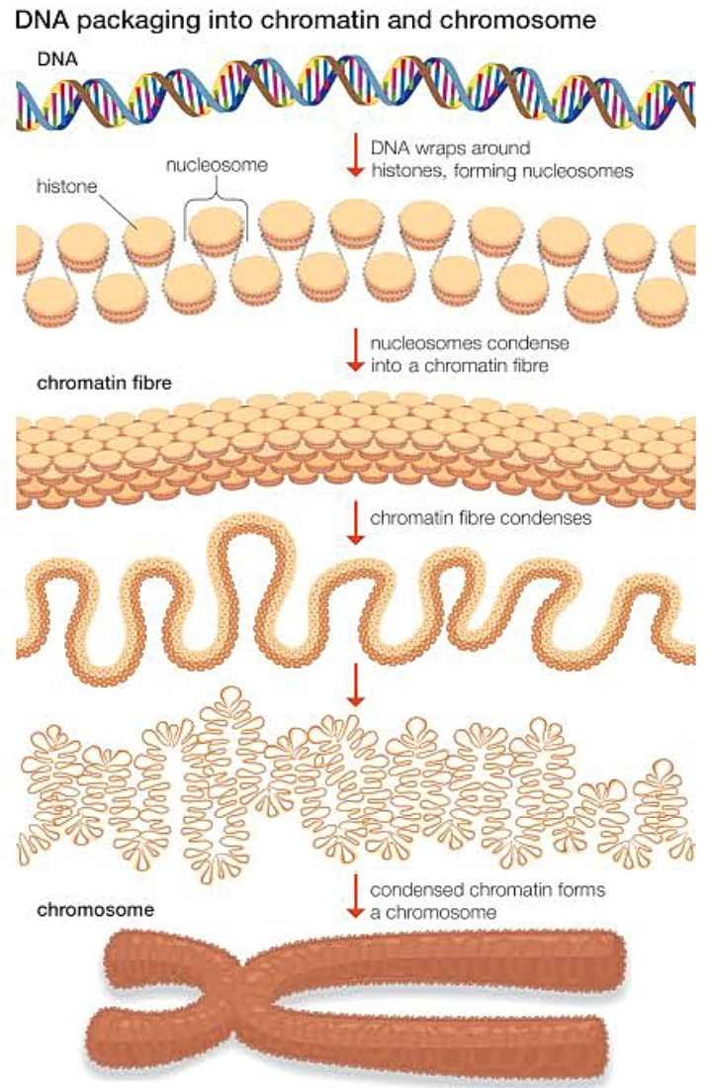

Slide 23
linker DNA, linker DNA is found to be 54 BP.
* The Nucleosome and H1 protein together constitute the chromatosome.
* 146 BP is found in chromatosome.
3:- Solenoid model :- The 6 Nucleosome cond-
ense to form the Solenoid.
* The Solenoid condense to form the super Solenoid.
*Super Solenoid condense to form chromatid.
* The 2 chromatid together form the chromosome.

Slide 24
Important of chromosome:- 1) It is genetic material of organism.
* The chromosome serves to transport the genetic material form one generation to anothe.
Conclusion
The above study show that the nucleus of all living organism is found to have a thread like structure called the chromosome, which acts to transfer genetic material form one generation to another.

Slide 25
Reference
1:-Book name - Fundamentals of genetics.
2:-Written by - B.D. Singh ( professor).
3:-Edition - 1st edition 1992 ,2nd edition
1995 , 3 rd edition 1997.
4:- Published by - Kalyani bublisher (head -
office).
1:- Book name -Book name - Cell biology.
2:- Written by - Dr. C.B. powar.
3:- Edition - 1st edition 1977, 2nd edition
1981.
4:- Published by - Himalaya publishing house.

Slide 26
Thank you
Thank you

